Slide 1
Network and Computer Security
Chapter 1 - Introduction
Prof. dr. ir. Eli De Poorter
© Eli De Poorter

Slide 2
What are we talking about?
What comes to mind when you hear
the term “Security”?

Slide 3
What are we talking about?
A few examples from the news
  “Social engineering”, Internet fraud, etc.
  Hackers
  Password security
  Privacy
  Security of confidential information
  Cybercrime, cyberterrorism, cyberwar, etc.
  Malware, ransomware …
  Did we mention the ethical aspects?

Slide 4



Starting with a secure computer
Apple pushes out first-ever automatic security
upgrade for Mac
2014-12-23
http://money.cnn.com/2014/12/23/technology/security/apple-automatic-security-upgrade/index.html
Number of viruses on Android smart phones increases spectacularly
Aantal virussen op Android-
smartphones stijgt spectaculair
2013-11-27
http://www.demorgen.be/technologie/aantal-virussen-op-android-smartphones-stijgt-spectaculair-a1748265/

Slide 5
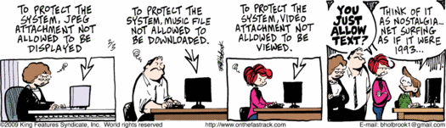

What about the user?
Secure or user-friendly?
2009-02-03 On the Fastrack

Slide 6
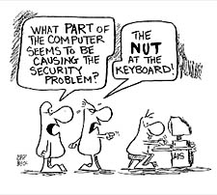

What about the user?
The user remains a security risk…
  Due to lack of knowledge…
1 in 10 in a survey think HTML is an STD
2014-03-04
http://www.latimes.com/business/technology/la-fi-tn-1-10-americans-html-std-study-finds-20140304-story.html

Slide 7
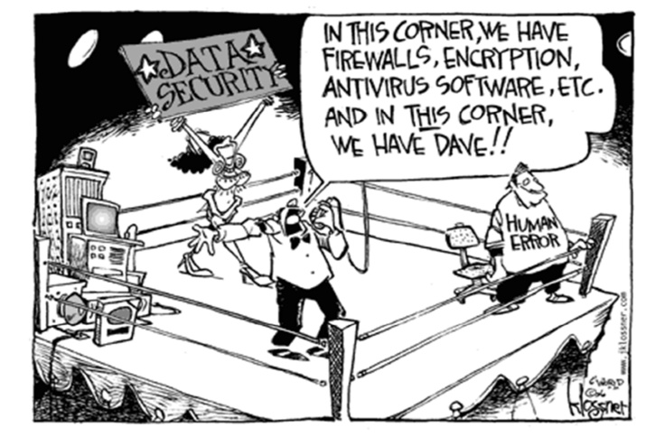
What about the user?
The user remains a security risk…
  Due to incompetence…

Slide 8
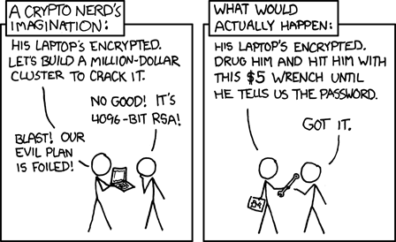
What about the user?
The user remains a security risk…
  Because information can still be shared non-digitally
Source: xkcd.com
http://xkcd.com/538/

Slide 9
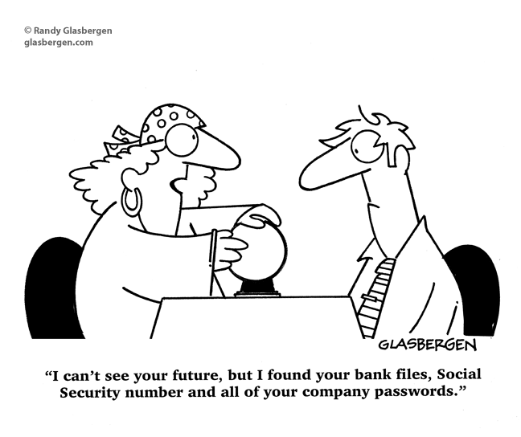
Social networks

Slide 10
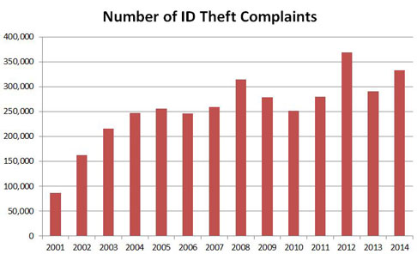
Identity information
Your Identity Is Worth $5 on the Black Market
In other words, significantly less than it's worth to you….
http://newsfeed.time.com/2013/08/26/your-identity-is-worth-5-on-the-black-market/
http://www.idtheftawareness.com/id_theft_pages/WhatIsIdTheft.php

Slide 11


So you think you’re safe?
NSA hackt Belgische cyberprof
2014-01-31
http://www.standaard.be/cnt/dmf20140131_049
Persoonlijke gegevens in databases niet altijd veilig
2014-10-16
http://deredactie.be/permalink/1.2120513
Apple to beef up security measures after nude photo leak
2014-09-04
http://money.cnn.com/2014/09/04/technology/security/apple-celebrity-photos/

Slide 12
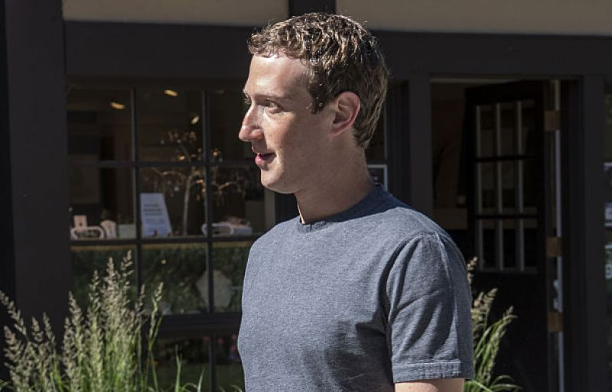
High profile targets
Notes:
Facebook advises its users to never reuse a password on multiple accounts, The Wall Street Journal points out. Had its CEO and founder took this advice more seriously, he could have prevented his Twitter and Pinterest accounts from being hacked this past June. Zuckerberg's not-so-difficult-to-guess password “dadada” -- which was originally leaked in 2012 when 100 million LinkedIn passwords were stolen -- proved not so strong against hackers.

Slide 13
So you think you’re safe?
Check it yourself!
  https://haveibeenpwned.com/

Slide 14
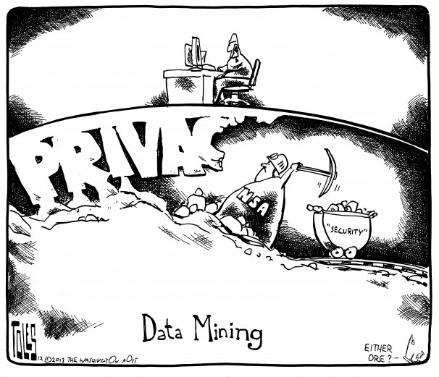
Privacy vs security
“Defending Our Nation”?
2013-12-20 Tom Toles

Slide 15
Privacy vs security
WAR IS PEACE
FREEDOM IS SLAVERY
IGNORANCE IS STRENGTH
George Orwell, “1984”
We are now 33 years later…

Slide 16
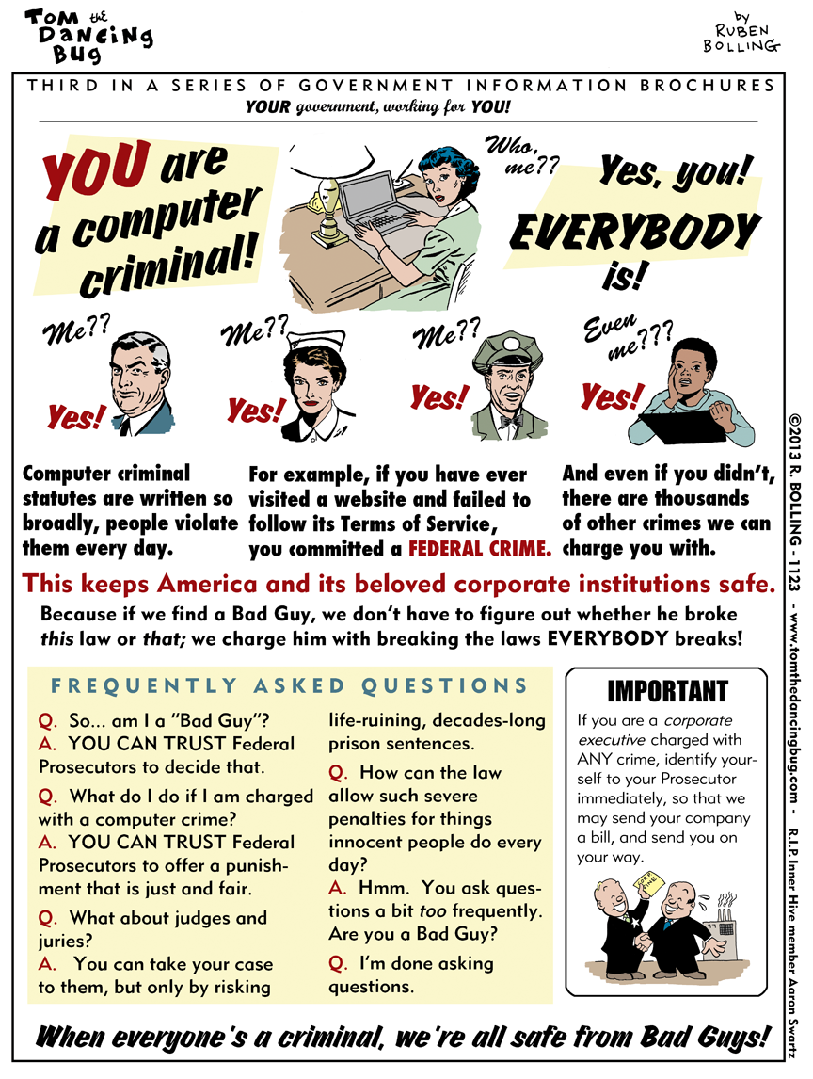
Source:
dailykos.com
http://boingboing.net/2013/01/30/tom-the-dancing-bug-you-are.html

Slide 17
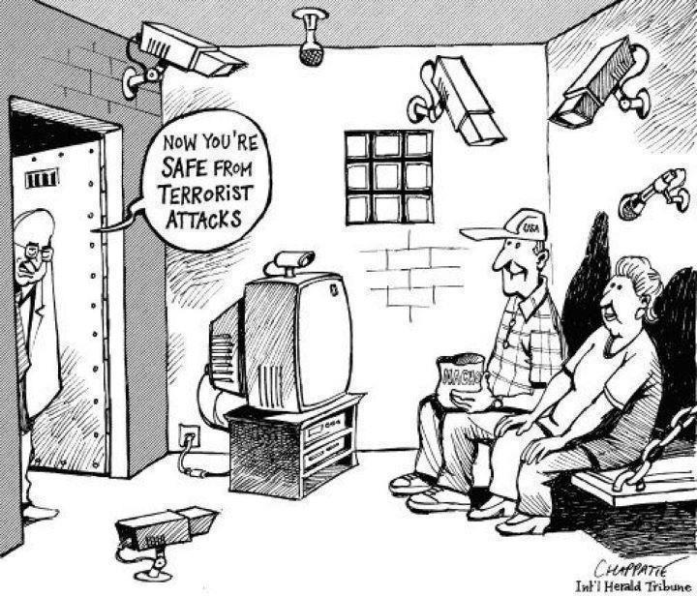
Privacy vs security
The cost of security
http://www.prosebeforehos.com/political-ironing/01/03/national-security-america/

Slide 18
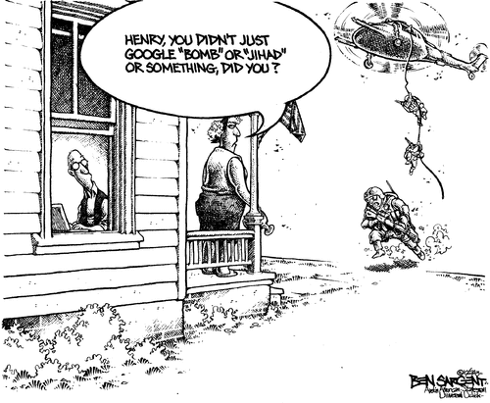
Privacy vs security
2013-10-31 Ben Sargent

Slide 19

Privacy vs security: only the NSA?
AIVD hackt internetfora, ‘tegen wet in’
2013-11-30
http://www.nrc.nl/nieuws/2013/11/30/aivd-hackt-internetfora-tegen-wet-in/
Revelations about the French Big Brother
Révélations sur le Big Brother français
2013-07-04
http://www.lemonde.fr/societe/article/2013/07/04/revelations-sur-le-big-brother-francais_3441973_3224.html
British intelligence hacked Belgian telephone company
Britischer Geheimdienst hackte
belgische Telefongesellschaft
2013-09-20
http://www.spiegel.de/netzwelt/web/belgacom-geheimdienst-gchq-hackte-belgische-telefongesellschaft-a-923224.html

Slide 20
Privacy vs security: consequences?
Here’s what can go wrong when the government builds
a huge database about Americans
2013-07-08
http://www.washingtonpost.com/blogs/wonkblog/wp/2013/07/08/heres-what-can-go-wrong-when-the-government-builds-a-huge-database-about-americans/
Every single IT guy, every single manager…
CROOKED TIMBER (blog)
2014-09-23
http://crookedtimber.org/2014/09/23/every-single-it-guy-every-single-manager/
Quis custodiet ipsos custodes?
(Juvenalis, Satire 6.346–348)

Slide 21
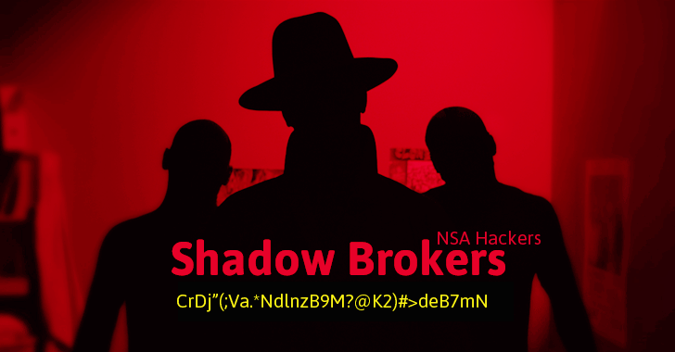
Privacy vs security: consequences?
Hacking group that obtained several NSA hacking tools
  First put them online for auction
  Afterwards put online for free

Slide 22
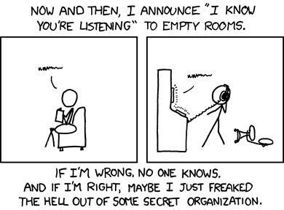
Privacy vs security: consequences?
http://xkcd.com/525/
Source: xkcd.com

Slide 23

And corporations aren’t any better
Facebook signs users up to privacy policy that
allows it to track you everywhere on the internet
2015-02-04
http://www.independent.co.uk/life-style/gadgets-and-tech/news/facebook-signs-users-up-to-privacy-policy-that-allows-it-to-track-you-everywhere-on-the-internet-10022530.html
Does Uber Even Deserve Our Trust?
2014-11-25
http://www.forbes.com/sites/chanellebessette/2014/11/25/does-uber-even-deserve-our-trust/

Slide 24
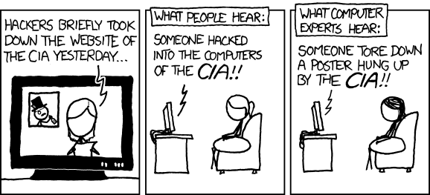
Media
http://xkcd.com/932/
Source: xkcd.com

Slide 25

Media: hackers… or swindlers?
Remain a critic, remain a sceptic
  Journalists aren’t always exactly IT experts!
Why I Am Skeptical About 1.2 Billion Passwords Being Stolen
2014-08-07
http://www.forbes.com/sites/josephsteinberg/2014/08/07/why-i-am-skeptical-about-1-2-billion-passwords-being-stolen/
Russian Hackers Amass Over a Billion Internet Passwords
2014-08-05
http://www.nytimes.com/2014/08/06/technology/russian-gang-said-to-amass-more-than-a-billion-stolen-internet-credentials.html

Slide 26
Is security unsolvable?
Internet bank fraud increased by 70% in 2013
Fraude met internetbankieren steeg met 70% in 2013
2014-02-10
http://www.deredactie.be/permalink/1.1869606
Number of Internet bank fraud cases strongly decreased
Aantal fraudegevallen met internetbankieren daalt sterk
2015-01-30
http://deredactie.be/permalink/1.2223667

Slide 27
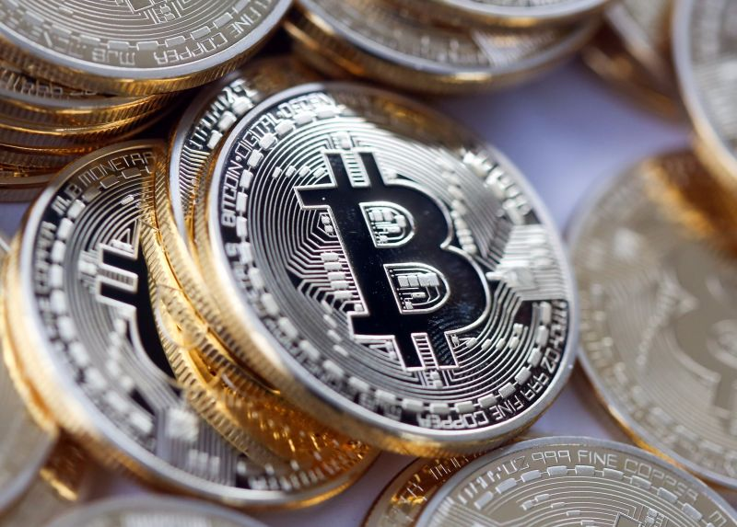
Future trends: bitcoin
Hackers steel $65 million from BitFinex
  The future for modern day bank robbers?
Notes:
Recognized as the second largest Bitcoin hack in history, criminals managed to break into BitFinex -- a Hong Kong exchange -- and steal more than $65 million-worth of digital currency. As the incident is investigated, the nature of the break in remains unknown as well as the identity of the responsible party.

Slide 28

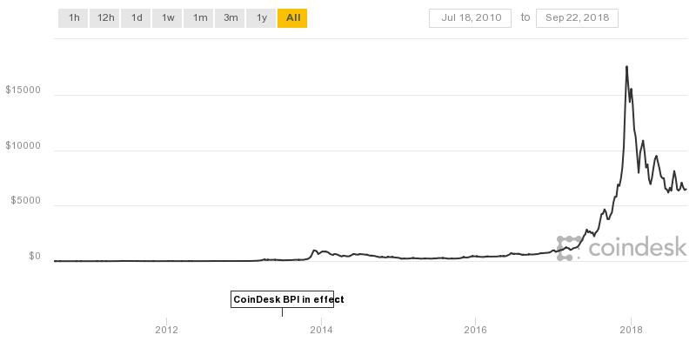
Future trends: bitcoin
Bitcoin bank Flexcoin closes after hack attack
2014-03-04
http://www.theguardian.com/technology/2014/mar/04/bitcoin-bank-flexcoin-closes-after-hack-attack

Slide 29
Future trends: blockchains
Even the US military is looking at blockchain technology—to secure nuclear weapons
  http://qz.com/801640/darpa-blockchain-a-blockchain-from-guardtime-is-being-verified-by-galois-under-a-government-contract/
  October 10, 2016
Blockchains are a key component of bitcoins
  Mainly used for data integrity through public ledgers
  Used to log activity
    Detect malicious operations, hackers, foreign surveillance, database modifications
    Equally important as access restrictions!

Slide 30
Future trends: cyber warfare
Cyber criminality vs cyber warfare
  Nation wide actions to cause damage or disruption
    Can include physical impact and/or harm to human persons
  Interesting targets: traffic lights, electricity systems, water filtration, power plants, …
Examples
  Stuxnet
    Worm that targeted Iranian nuclear facilities, damaging centrifuges and other hardware
    Most likely an American-Israeli cyberweapon
  Petya: ransomware or state attack?
    Focused strongly on Ukraine systems
    Made very little money
    Either very buggy, or very damaging by purpose
      Permanent removal of files, nuclear power plants, ministries, metros and banks offline, possible link with assassination of Maksym Shapoval
Notes:
The difference between cyber criminality and cyber warfare is often denoted as the real-world physical impact; whereby cyber criminality will often have a clear impact to the real world, cyber warfare adds the physical impact to such activities (cyber warfare results in people being physically harmed in the real world). The image of the hacker wearing a hoody at night in a basement is long gone; organized crime and even state actors have found their way to cyberspace. The threat of real-world physical damage was probably first widely demonstrated by Stuxnet, and the threat of cyber criminals (or warriors) taking over traffic lights, nuclear power plants and water filtration plants is more prominent than ever.
Further research and investigation into Petya ransomware -- which has affected computers in over 60 countries -- suggest three interesting things: 1. Ukraine was the epicentre of the attack. According to Kaspersky, 60 percent of all machines infected were located within Ukraine. 2. The attackers behind the attack have made little money -- around $10,000. Which leads to speculation that perhaps money wasn't a motive at all. 3. Petya was either "incredibly buggy, or irreversibly destructive on purpose." Because the virus has proven unusually destructive in Ukraine, a number of researchers have come to suspect more sinister motives at work. Peeling apart the program's decryption failure in a post today, Comae's Matthieu Suiche concluded a nation state attack was the only plausible explanation. "Pretending to be a ransomware while being in fact a nation state attack," Suiche wrote, "is in our opinion a very subtle way from the attacker to control the narrative of the attack." Another prominent infosec figure put it more bluntly: "There's no fucking way this was criminals." There's already mounting evidence that Petya's focus on Ukraine was deliberate. The Petya virus is very good at moving within networks, but initial attacks were limited to just a few specific infections, all of which seem to have been targeted at Ukraine. The highest-profile one was a Ukrainian accounting program called MeDoc, which sent out a suspicious software update Tuesday morning that many researchers blame for the initial Petya infections. Attackers also planted malware on the homepage of a prominent Ukraine-based news outlet, according to one researcher at Kaspersky.

Slide 31
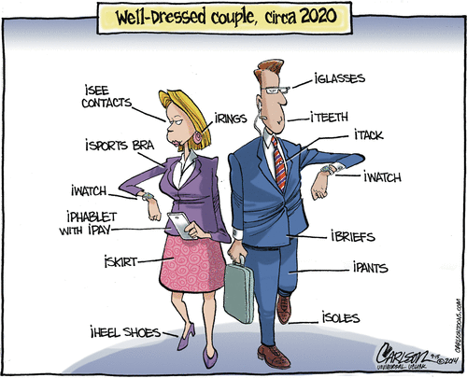
Future trends: IoT
2014-09-15 Stuart Carlson

Slide 32

Future trends: IoT
How far is this future?
Cheney's defibrillator was modified to prevent hacking
2013-10-24
http://www.cnn.com/2013/10/20/us/dick-cheney-gupta-interview/

Slide 33
Overview
Security in the media
Recent major incidents
  Ashley Madison (2015)
  Democratic National Committee email leak (2016)
  Mirai (2016)
  WannaCry (2017)
Why do we need security?
Scope of the course

Slide 34
Ashley Madison data breach
What?
  A commercial website for enabling extramarital affairs
Perpetrators: "The Impact Team“
  Stolen items
    Personal information from users, e-mails and corporate data
  Demands
    Shut down of the site
Motivation
  “ethical” hacking…?
Results
  Insights in falsified profiles
  Broken marriages, several suicides
  Damage up to …. millions?
Notes:
Passwords on the live site were hashed using the bcrypt algorithm. A security analyst using the Hashcat password recovery tool with a dictionary based on the RockYou passwords found that among the 4,000 passwords that were the easiest to crack, "123456" and "password" were the most commonly used passwords on the live website. An analysis of old passwords used on an archived version showed that "123456" and "password" were the most common. Due to a coding error where passwords were hashed with both bcrypt and md5. 11 million passwords were eventually cracked.

Slide 35
Overview
Security in the media
Recent major incidents
  Ashley Madison (2015)
  Democratic National Committee email leak (2016)
  Mirai (2016)
  WannaCry (2017)
Why do we need security?
Scope of the course

Slide 36
Democratic National Committee email leak
Democratic National Committee (DNC) emails
  Hackers obtained 19,252 emails and 8,034 attachments
  Published on WikiLeaks on July 22, 2016
Perpetrators
  Russian Intelligence services (according to FBI & several cybersecurity firms)
Motivation
  Mainly political?
Impact
  Several resignations
  Insights in donor information & lack of neutrality of DNC vs other candidates (e.g. Bernie Sanders)
  The rise of a certain president candidate named Trump….

Slide 37
Overview
Security in the media
Recent major incidents
  Ashley Madison (2015)
  Democratic National Committee email leak (2016)
  Mirai (2016)
  WannaCry (2017)
Why do we need security?
Scope of the course

Slide 38
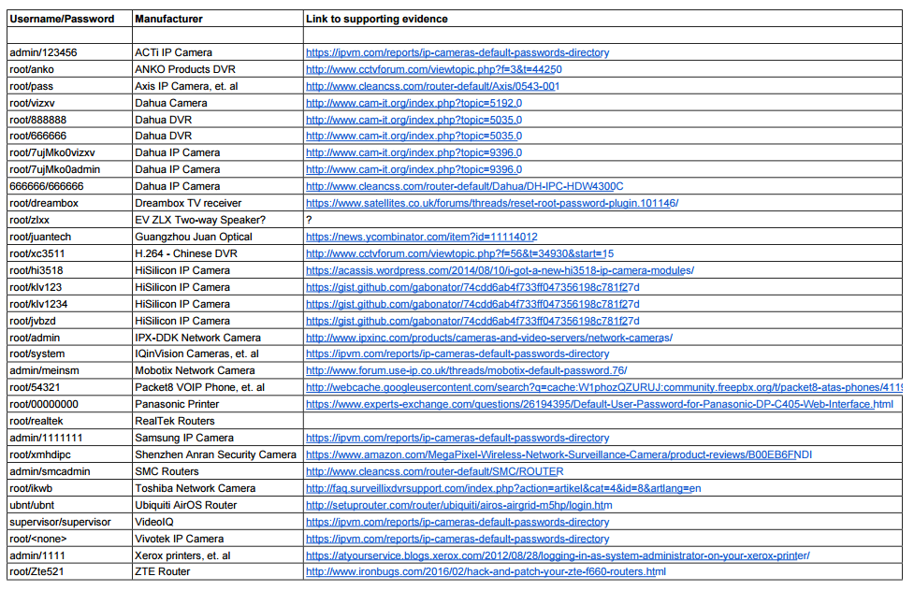
IoT botnet Mirai
IoT botnet Mirai
  Botnet of 380 000 devices, mainly IoT (IP cameras)
    Management and control traffic is encrypted
  Exploits unpatched vulnerabilities & default passwords
    Also takes over devices infected by Bashlight (and patches them himself)
  Used for DDoS
    E.g. up to 1Tbit/sec
Notes:
https://arstechnica.com/information-technology/2016/10/double-dip-internet-of-things-botnet-attack-felt-across-the-internet/

Slide 39
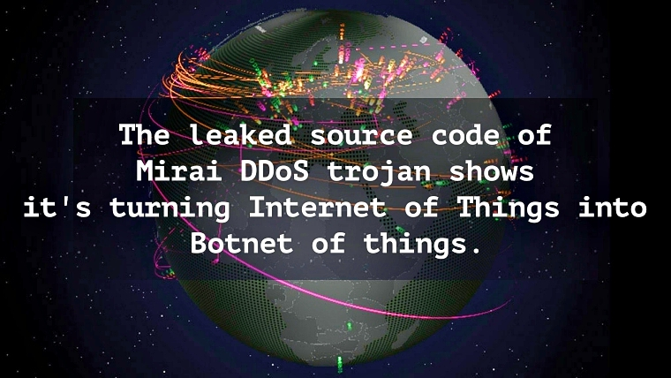
IoT botnet Mirai
October 2016
  Released as open source by creator
  https://github.com/jgamblin/Mirai-Source-Code
Reason
  Backdoor?
  Afraid of security firms? …
Notes:
https://arstechnica.com/information-technology/2016/10/double-dip-internet-of-things-botnet-attack-felt-across-the-internet/
https://tweakers.net/nieuws/116329/broncode-van-malware-achter-iot-botnet-mirai-verschijnt-online.html

Slide 40
Overview
Security in the media
Recent major incidents
  Ashley Madison (2015)
  Democratic National Committee email leak (2016)
  Mirai (2016)
  WannaCry (2017)
Why do we need security?
Scope of the course

Slide 41
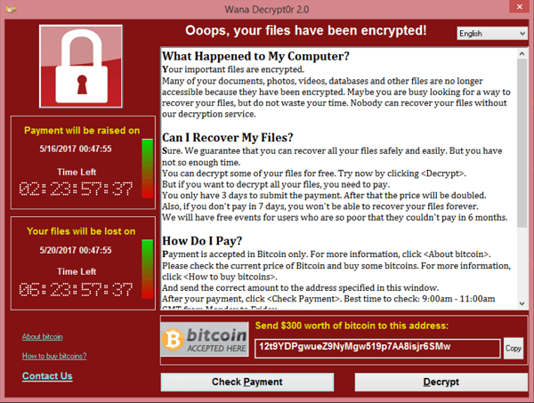
WannaCry
Ransomware
  Encryption of PC data
  Utilized exploit of Windows SMB
    Previously discovered and exploited by NSA, but never reported
  200,000 infected computers across 150 countries

Slide 42
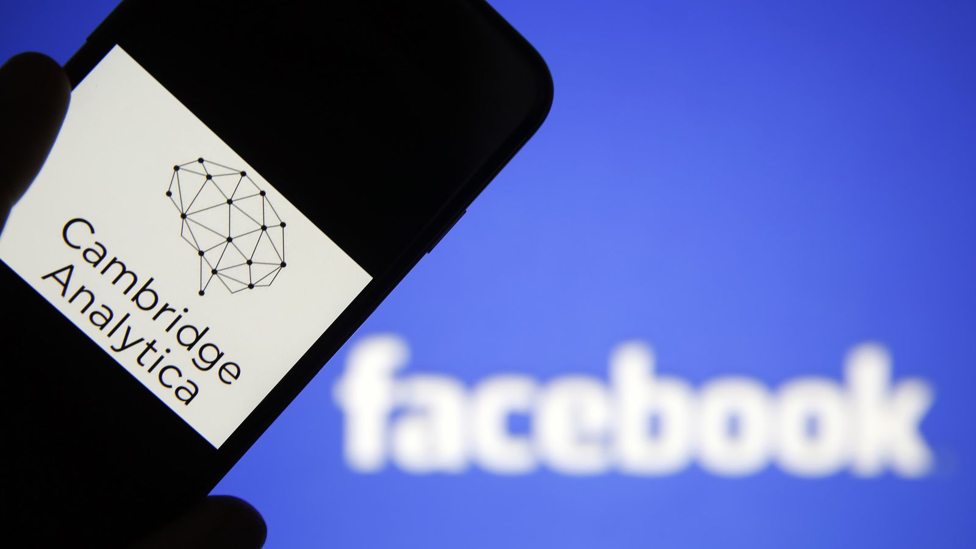
Facebook & Cambridge Analytica
Notes:
Cambridge Analytica is a UK-based data analytics firm, whose parent company is Strategic Communication Laboratories. Cambridge Analytica helps political campaigns reach potential voters online. The firm combines data from multiple sources, including online information and polling, to build "profiles" of voters. It then uses computer programs to predict voter behavior, which could be influenced through specialized advertisements aimed at the voters. Cambridge Analytica reportedly acquired the data in a way that violated the social network's policies. It then reportedly tapped the information to build psychographic profiles of users and their friends, which were used for targeted political ads in the UK's Brexit referendum campaign, as well as by Trump's team during the 2016 US election.
Facebook said in a statement on March 16 that Cambridge Analytica received user data from Aleksandr Kogan, a lecturer at the University of Cambridge. Kogan reportedly created an app called "thisisyourdigitallife" that ostensibly offered personality predictions to users while calling itself a research tool for psychologists. The app asked users to log in using their Facebook accounts. As part of the login process, it asked for access to users' Facebook profiles, locations, what they liked on the service, and importantly, their friends' data as well. The problem, Facebook says, is that Kogan then sent this user data to Cambridge Analytica without user permission, something that's against the social network's rules. The New York Times characterized the original problem as a data "breach" and said it's "one of the largest data leaks in the social network's history." That's in part because the roughly 270,000 users who gave Kogan access to their information allowed him to collect data on their friends as well. In total, more than 87 million Facebook users are said to have been affected. Facebook has been fined half a millions pound by the British privacy commission, the largest fine possible.

Slide 43
Overview
Security in the media
Recent major incidents
Why do we need security?
Scope of the course

Slide 44
Why?
Why Information Security?
  Counterpart of securing material objects
    Material object have some value
      Value can often easily be determined (except for affective value)
    Can be stolen or damaged
      Causes material damage (replacement of the object, interruption of business process, etc.)
      Most damage is repairable (replacement or repair)
    Cost for security/protection takes into account:
      Value of the object
      Risk of theft/damage

Slide 45
Why?
Why Information Security?
  The risk of threats against information security is MUCH greater than the risk of threats against material objects
    Much more diverse attacks because of available computation power and almost ubiquitous network connectivity
  Value of information
    Sometimes hard to assess
    Best estimated by damage caused
      When information security is breached
      But even this can be hard:
        what is the value of someone’s privacy?
    However, loss of information can not be undone!
  Threats against information
    Loss of information
    Forged information
    Unauthorised release of information
    Repudiation of information
    etc.

Slide 46
Why?
Why Information Security?
  Value of information systems
    Also hard to assess
    Systems are meant to enable some service
      Damage when service is unavailable or unreliable
  Threats against information systems
    Unavailability/disruption of service
    Unauthorised access to service
    Threats against exchanged information
    etc.
  Security measures for information systems
    Information security: encryption, virus scanners, firewalls, etc.
    Also carry some cost
      installation, maintenance, computation time, lost ease-of-use, etc.
    Here too, dependent on…
      …risk of security breach
      …potential damage in case of breach

Slide 47
Overview
Security in the media
Recent major incidents
Why do we need security?
Scope of the course

Slide 48
Scope of the course
Chapter 1: Introduction
Chapter 2: Basic concepts
Chapter 3: Network and communication security
Chapter 4: Encryption algorithms
Chapter 5: Software and systems security
Chapter 6: Intrusion detection
Chapter 7: Future trends
Chapter 8: Legal aspects
Chapter 9: Guest speakers

